Slide 1
DEPARTMENT OF PHYSICS
SRM INSTITUTE OF SCIENCE AND TECHNOLOGY
18PY103J – Physics: Semiconductor Physics
Module-I, Lecture-16
Numericals Based on Fermi Level and Fermi Distribution Fuction
18PYB101J Module-I Lecture-16
18PYB103J Module-I Lecture-1

Slide 2
The Fermi level for potassium is 2.1eV. Calculate the velocity of the electron at the Fermi level.
Solution:-
We have the formula, 𝐸 _{𝐹} = 1/ 2 𝑚𝑣 _{𝐹} ²
Therefore, 𝑣 _{𝐹} = ( 2𝐸 _{𝐹} /𝑚 )^{1/2}
= (2 × 2.1× 1.602 × 10−19 /9.11 × 10−31) ^{1/ 2}
𝑣 _{𝐹} = 8.6 × 10 5 𝑚/𝑠.
18PYB101J Module-I Lecture-16

Slide 3
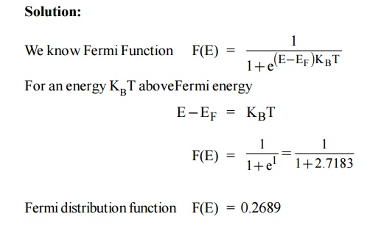
2 . Evaluate the Fermi function for energy K_{B}T above the Fermi energy.
18PYB101J Module-I Lecture-16

Slide 4
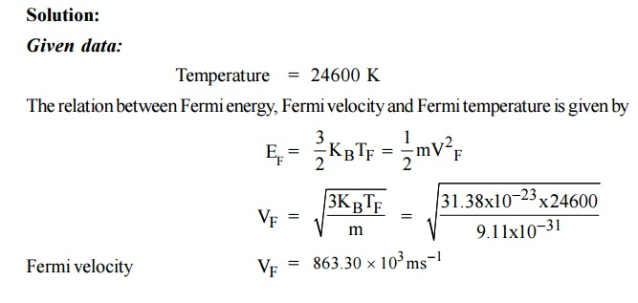
3. The Fermi temperature of a metal is 24600 K. Calculate the Fermi velocity.
18PYB101J Module-I Lecture-16

Slide 5
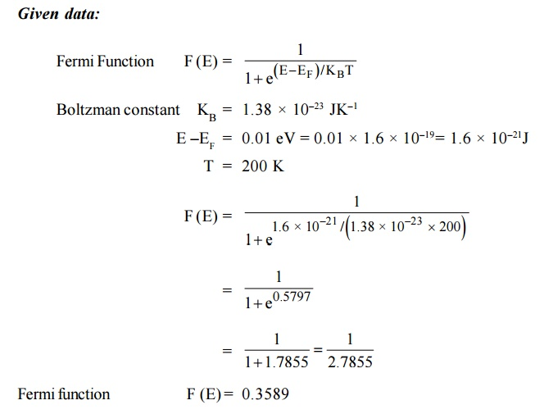
4. Use the Fermi distribution function to obtain the value of F(E) for E – E_{F} = 0.01 eV at 200K.
18PYB101J Module-I Lecture-16

